Slide 1
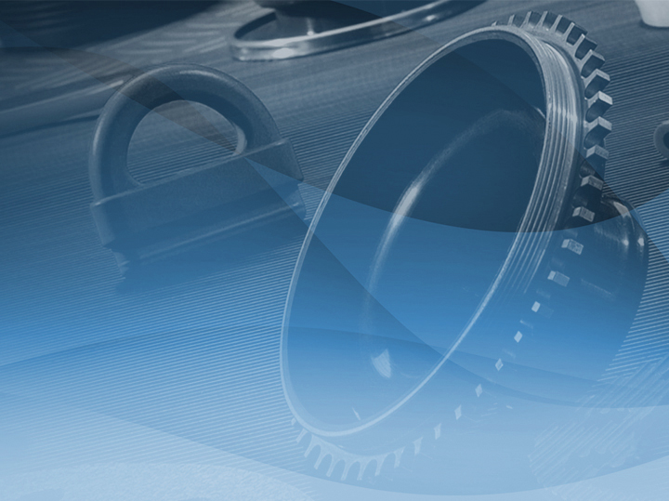
ISO 9001:2015 / IATF 16949:2016 MINORITY BUSINESS ENTERPRISE
www.COiRUBBER.com

Slide 2
INTRODUCTION
INTRODUCTION
PRODUCTS
INDUSTRIES
ENGINEERING
QUALITY ASSURANCE
www.COiRUBBER.com

Slide 3
INTRODUCTION
Coi Rubber Products was established to service
the Rubber & Plastics Industry
Coi Rubber Products was established to service the Rubber & Plastics Industry. We started in molded products serving the agriculture industry.
Since then, we have expanded into a variety of rubber products which includes molding, extrusion, and rubber-to-metal bonding.
We serve a wide variety of companies in different industries; some industries include the Automotive, Industrial, Food Processing, HVAC, Appliance, Baby Products, and many more.
We offer injection molded rubber, or any custom rubber or plastic products. We offer competitive pricing, fast lead time, and US local customer and engineering service.
Together We can grow exponentially
www.COiRUBBER.com

Slide 4
INTRODUCTION
Locations
Manufacturing, Engineering, Distribution, Sales:
(Combined ~1,500,000 sq. ft.)
(HQ, DISTR.) | Los Angeles, California, USA
(SALES) | Dayton, Ohio, USA
(SALES) | Juárez, México
(MFG) | Anhui, China
 | Shanghai, China
 | Zhejiang, China
www.COiRUBBER.com

Slide 5
INTRODUCTION
PRODUCTS
PRODUCTS
INDUSTRIES
ENGINEERING
QUALITY ASSURANCE
www.COiRUBBER.com

Slide 6
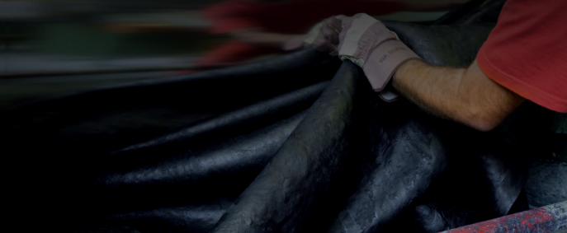
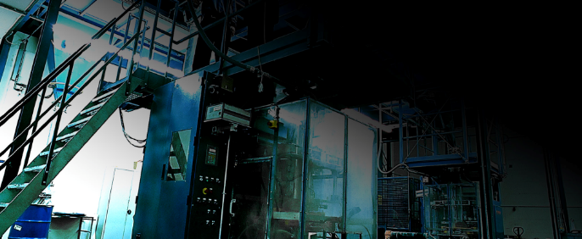
Production Capabilities
Rubber
Injection Molding
Compression Molding
Transfer Molding
Rubber to Metal Bonding
Insert Over-Molding
Plastic
Injection
Extrusion
Thermoform
Rubber Extrusion
Dense
Sponge
Dual Durometer
www.COiRUBBER.com

Slide 7
Production Capabilities
Materials and Applications Coi Rubber Products has in-house custom compounding capabilities for all your proprietary specifications, saving you cost and improving performance.
MATERIALS
• (IR) Synthetic Rubber
• (NR) Natural Rubber
• (EPDM) Ethylene-Propylene-Diene-Monomer
• (FKM/FPM) Fluorocarbon, Viton
• (NBR) Nitrile, Buna-N
• (SBR) Styrene Butadiene
• (CO, ECO) Epichlorohydrin
• (CR) Chloroprene, Neoprene
• (IIR) Butyl/Isobutylene Isoprene
• (VMQ/FVMQ) Silicone/FluorosIlicone
• (PU) Polyurethane
• (PE/LDPE/HDPE) Polyethylene
• (ABS) Acrylonitrile-Butadiene-Styrene
• (TPE/TPV) Thermoplastic
• (PP) Polypropylene
• (PVC) Polyvinyl Chloride
• (PA/PA66) Nylon, Polyamide, Glass-Filled
APPLICATIONS
• Molded Gaskets & Seals
• Boots
• Bushings
• Grommets
• Isolators & Fitting
• Bellows
• Baffles/Shields
• NVH (Noise, Vibration, Harshness)
• Grips/Knobs
• Body Molding Closeouts
• Hose Clamps
• Molded Hoses
• Diaphragms
• O-rings
• Interior Inserts
• Housings
• Terminal Covers
• And many more…
www.COiRUBBER.com

Slide 8
INTRODUCTION
PRODUCTS
INDUSTRIES
INDUSTRIES
ENGINEERING
QUALITY ASSURANCE
www.COiRUBBER.com

Slide 9
INDUSTRIES
Across many markets and industries, hundreds of companies rely on Coi Rubber to provide exceptional rubber products and services to support their success.
AUTOMOTIVE
TRUCKING
AGRICULTURE & CONSTRUCTION
RECREATIONAL
VEHICLE
INDUSTRIAL
ELECTRONICS
AEROSPACE
MEDICAL
www.COiRUBBER.com

Slide 10
INTRODUCTION
PRODUCTS
INDUSTRIES
ENGINEERING
ENGINEERING
QUALITY ASSURANCE
www.COiRUBBER.com

Slide 11
ENGINEERING
Product Review & Engineering
Our Engineers Solve Problems & Save You Money
Shipping reliable production at competitive prices to our customers is only one part of the Coi Rubber Products advantage. Run-of-the-mill parts can only go so far. Coi Rubber is uniquely capable of providing comprehensive solutions to complex problems.
From custom material design, cost saving suggestions, to form-fit-and-function, our team is here to listen to your needs and develop the perfect solutions throughout your design process.
DATA EXCHANGE | FILE TRANSLATORS TO & FROM NEARLY ALL MECHANICAL CAD PRODUCTS
Design communication
Detailed parts analysis
Mold design tools
Consumer product design tools
Speed part modeling over multiple bodies and unique specification
Reference other parts directly and maintaining relationships with new part
Speed Assembly Design locating conflicting mate relationships
Simulate True Motion and mechanical interactions
Compound development with relation to geometrical prediction on function
Generate complex surfaces using Mold-Tech and Tenibac
Product manipulation for material reduction or alternative geometrical outcome
Scale and pattern surfaces
Rapid prototyping
Sample one off tooling
www.COiRUBBER.com

Slide 12
ENGINEERING
Product Review & Engineering
We have accumulated a vast library of documentation and experience in technical standards over the years – from well-known American standards like ASTM, SAE, and RMA to internationally recognized standards such as ISO, DIN, and JIS.
Additionally, our library of documentation and experience includes OEM specific standards as well as catering to customer-defined unique testing requirements.
Standards and Specifications (incl., not limited to):
• ASTM
• SAE
• ISO
• RMA
• DIN
• JIS
• Mold-Tech
• Tenibac • Pantone
• HES
• Ford
• Toyota
• CAT
• CNH
• John Deere
• PACCAR
• GE
• 3M
• IGS
• STEP
• CATIA
• PRT
• STL
• DWG
• DXF
• PDF
• TIFF
www.COiRUBBER.com

Slide 13
ENGINEERING
Product Review & Engineering
Our Engineers Solve Problems & Save You Money
Your business and profitability is important to us. If our products perform better, last longer, or simply outperform a competitor’s component, we’ve effectively brought value to your business.
That’s why our product design and engineering team has expertise not just in mechanical engineering, but in the rubber and plastic materials, mold making, and testing.
The group includes members with specialized expertise in specific product lines, including molded hoses, shaft seals, molded surfacing products and vibration-control products.
Our team members use the latest design and testing technology to create drawings that are compatible with customers’ systems and to verify that parts can withstand real-world demands for both performance and manufacturability.
Our designers use SolidWorks, Pro-E, and other design software and emulators to begin the work and interact with your formats.
When the initial product design is complete, our Rapid Tooling center can make a mold and quickly produce prototype parts. Contact us to learn more about our lead time and accountability.
www.COiRUBBER.com

Slide 14
INTRODUCTION
PRODUCTS
INDUSTRIES
ENGINEERING
QUALITY ASSURANCE
QUALITY ASSURANCE
www.COiRUBBER.com

Slide 15
QUALITY ASSURANCE
Coi Rubber Products
Quality Assurance and Control
We understand that our customers must be able to count on us with each and every order, to provide exactly the parts they need, without surprises.
That’s why we adhere to and are certified for the rigorous procedural standards defined by the stringent IATF 16949:2016 quality management system relied on by the automotive industry.
In addition, we are committed to providing comprehensive Production Part Approval Process (PPAP) documentation / APQP Reports / and full documentation on 8-D and 5 Factor Tree Analysis on Quality Management Controls.
From the factory floor to the customer’s door, we never stop thinking about quality and our commitments and plans are robust enough to ensure your peace of mind that the “millionth” part received is just as the samples you approved.
www.COiRUBBER.com

Slide 16
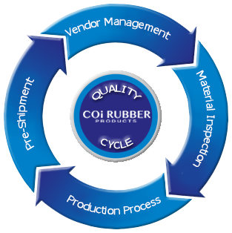
QUALITY ASSURANCE
Quality Assurance and Control
IATF 16949:2016 certified QMS
In conjunction with ISO 9001:2015
PPAP, APQP reports, 8-D Problem Solving, 5 Factor Tree Analysis
Full compliance to each customer’s agreed upon quality requirements with documentation guaranteed
Quality Controls at every level: (1) Raw material supply (2) Material batch inspection (3) Production processes (4) Pre-shipment inspection
In-House Laboratory Testing:
ASTM Standard
ISO Standard
OEM Standard
Customer specified
Read Our Quality Manual Online:
www.COiRUBBER.com

Slide 17
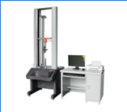
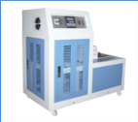
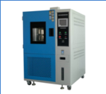
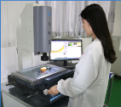
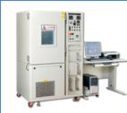
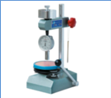
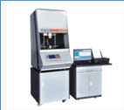
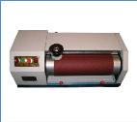
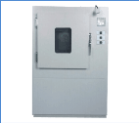
QUALITY ASSURANCE
In-House Laboratory Testing Capabilities
Tensile & Elongation
Hardness (Durometer)
Ozone Test Chamber
Heat Age Test Chamber
Mooney Viscometer
Low Temperature Brittleness
Xenon Test Chamber
Abrasion
Gravimeter
Salt Spray
Sulfur Analysis
Digital Caliper
Microscopy
Non-Contact CMM
External testing also available incl. A2LA, ISO/IEC 17025, etc.
www.COiRUBBER.com

Slide 18
ORDER EXECUTION
Order Execution Process
Each process is fully documented and traceable.
Order
Production Planning
Arrange
production
Packaging
Arrange the project
Mold Design
Warehouse or
Sea / Airport
Our engineers plan
the project
Mold Making
Tooling process
Customer
Production
Samples
Products
Sample Order
Customer Approval
QC
Samples
Products
Product Order
www.COiRUBBER.com

Slide 19
PROCESS CHART
Customer
Business Planning
Order Handling
Warehousing & Maintenance
Manufacturing
Admin
Inspection & Delivery
Subcon Plating & Testing
Review and Improvement
Customer
Management Responsibility &
Resource Management Plan
Product/Service Realization (Do)
Monitoring & Measurement (Check-Act)
www.COiRUBBER.com

Slide 20
INDUSTRIES
SALES % BASED ON INDUSTRY
Don’t be surprised if you find out that a component you used is made by COI RUBBER!
www.COiRUBBER.com

Slide 21
GLOBAL EXPORT
COI Rubber International Presence
Don’t be surprised if you find out that a component you used is made by COI RUBBER!
www.COiRUBBER.com

Slide 22
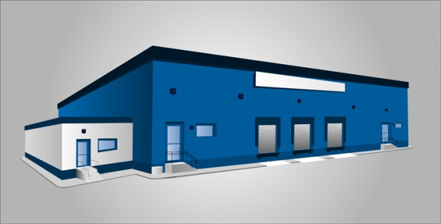
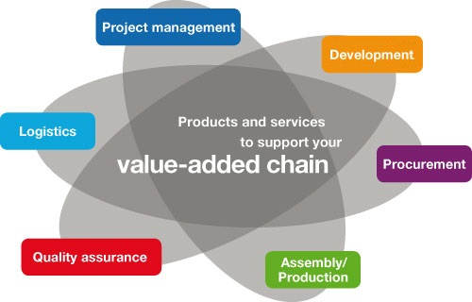
US-OWNED FACTORY
COI Rubber International Presence
Don’t be surprised if you find out that a component you used is made by COI RUBBER!
Coi Rubber Products, Inc. now covers ~1,500,000 sq. ft.!
Our new plant in Anhui, China, ~215,000 sq. ft., was built in 2014 to support our exponential business growth!
Early Mock-Up
See next slides for completed plant photos
GLOBAL SOURCING FOR A GLOBAL ECONOMY
Today most companies utilize global sourcing as a key component of their procurement strategy to expand or develop markets as they look to decrease costs. Our 4th facility in Anhui provides an additional 215k sq. ft. adding to a total manufacturing facility exceeding 1.5M sq. ft.
www.COiRUBBER.com

Slide 23
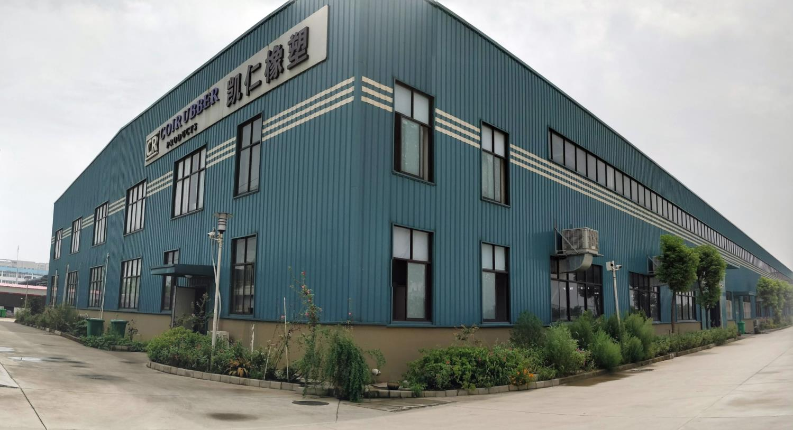

Slide 24
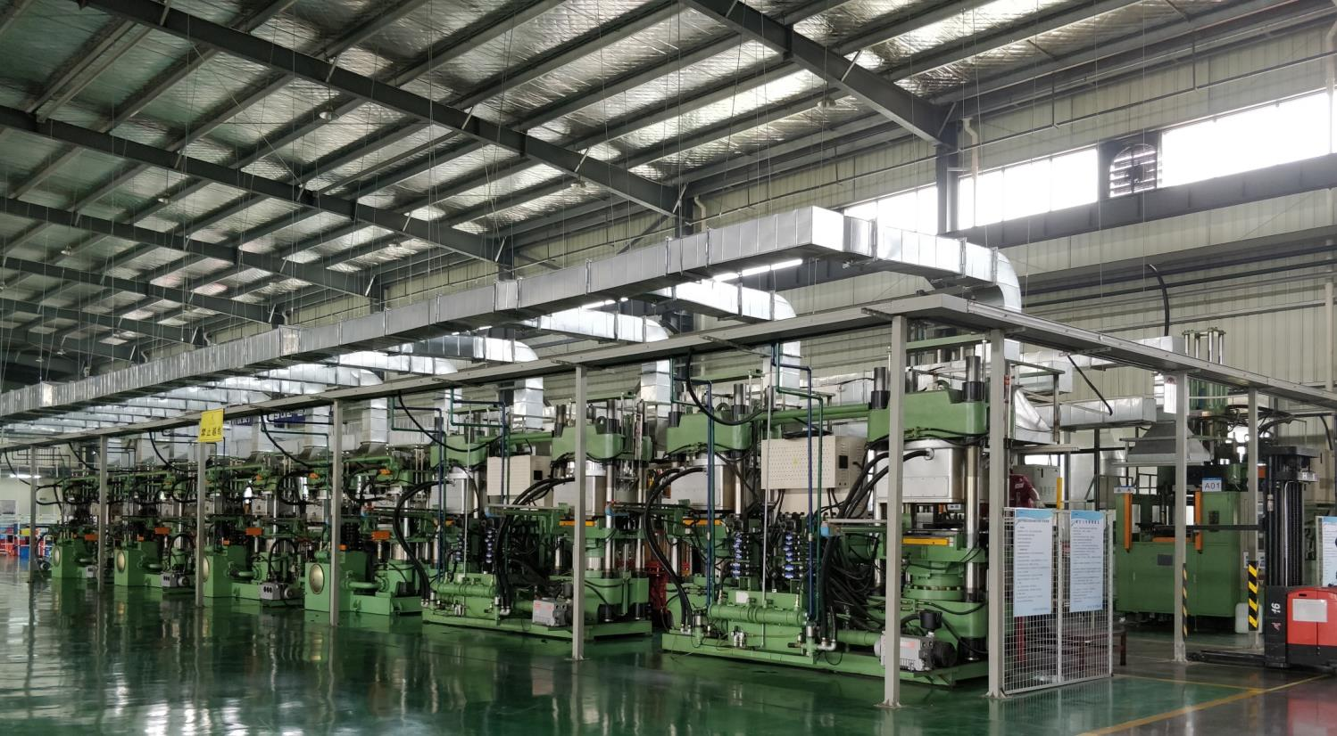
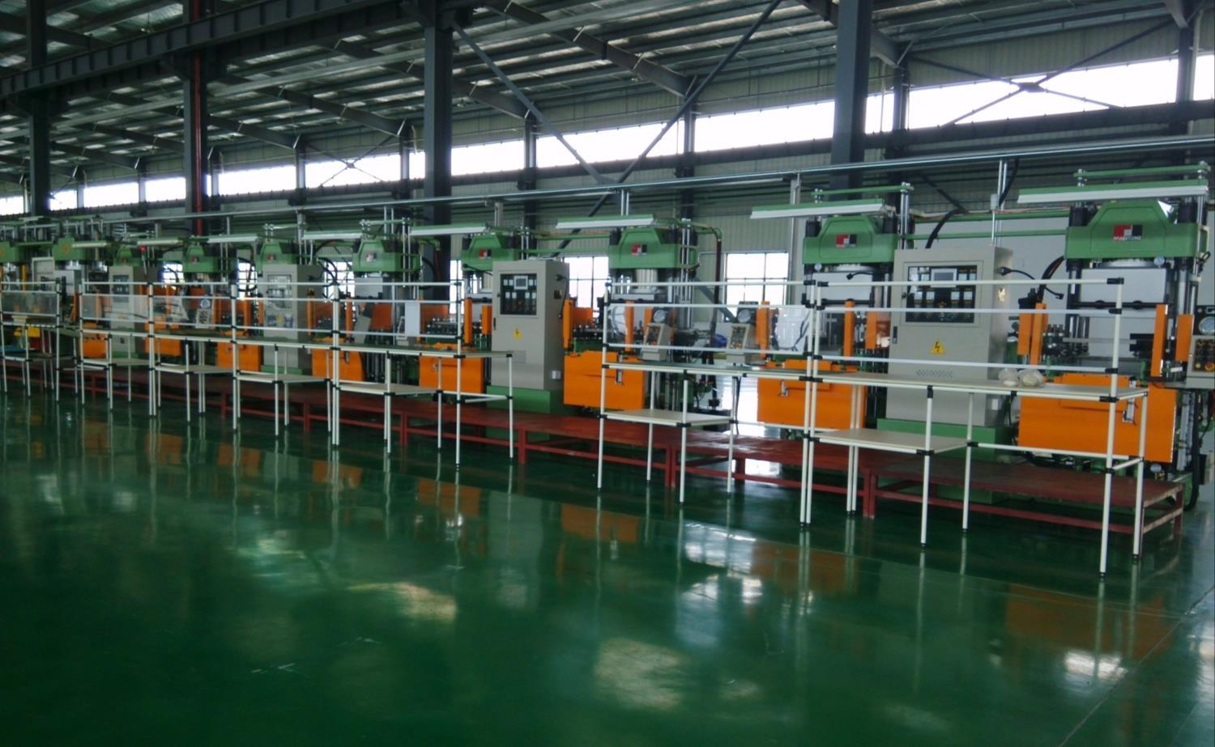

Slide 25
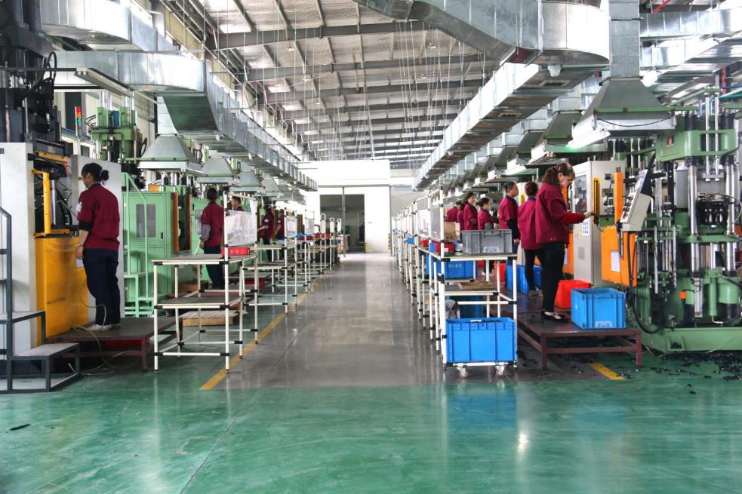
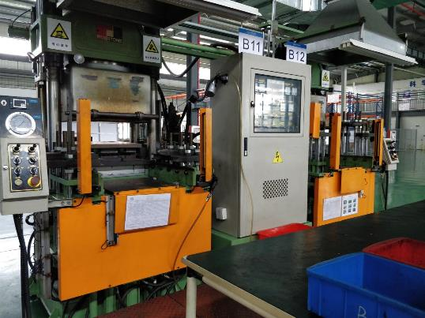
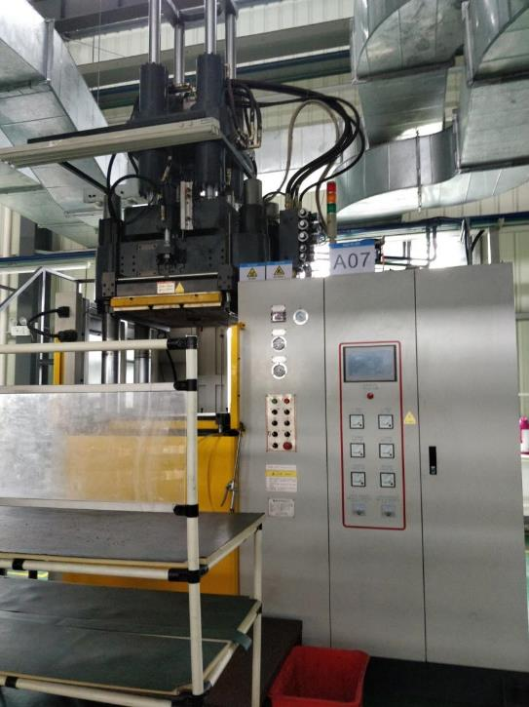
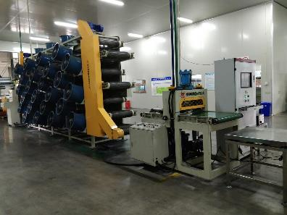
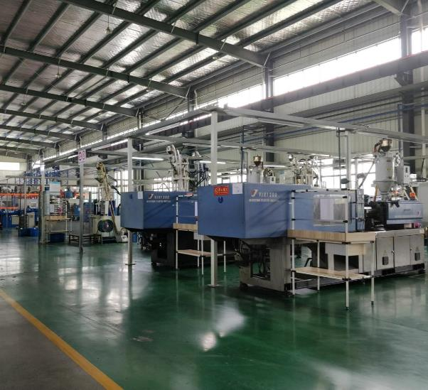
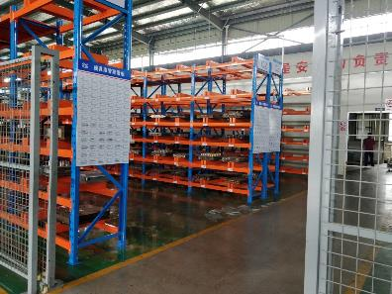

Slide 26
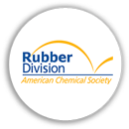
ORGANIZATIONS
Certified MBE – Minority Business Enterprise
TLARGI – American Chemical Society, Los Angeles Chapter
Energy Polymer Group, Inc.
WIPO Madrid Registered Trademark
USPTO Registered Trademark
www.COiRUBBER.com

Slide 27
If you have a question or inquiry, please do not hesitate to give us a call or e-mail us.
CONTACT CORPORATE OFFICE:
Coi Rubber Products, Inc.
19255 San Jose Avenue Unit D-1
City of Industry, CA 91748
Phone (USA): (626) 965-9966
Fax Number: (626) 581-2335
E-Mail: sales@CoiRubber.com
Website: www.COiRUBBER.com
www.COiRUBBER.com

